Slide 1

Building a Flight Booking Chatbot
Presented by: Octave Antoni
Last Updated: November 23th, 2022

Slide 2
Table of contents
Introduction
Training and Testing the Model
Developing the Bot
Monitoring the Bot Performance
Conclusion

Slide 3
Introduction
Main goal ➔ Create a flight booking bot that is able to understand 5 elements in user requests: start and return dates, departure and destination cities and budget.
Use of the Microsoft Frames dataset (opensource)
Implement a monitoring strategy
Key points :
Development of a language understanding model using Azure LUIS
Bot built using Microsoft BotFramework SDK
Performance metrics and logs saved to Azure Insights
Creation of a dashboard to visualize real-time performance data
Limitation : Azure Credits not provided to student ➔ Limited number of request to LUIS model ➔ Model testing with labelled data could only be done with JSON import

Slide 4
Training and Testing the Model

Slide 5
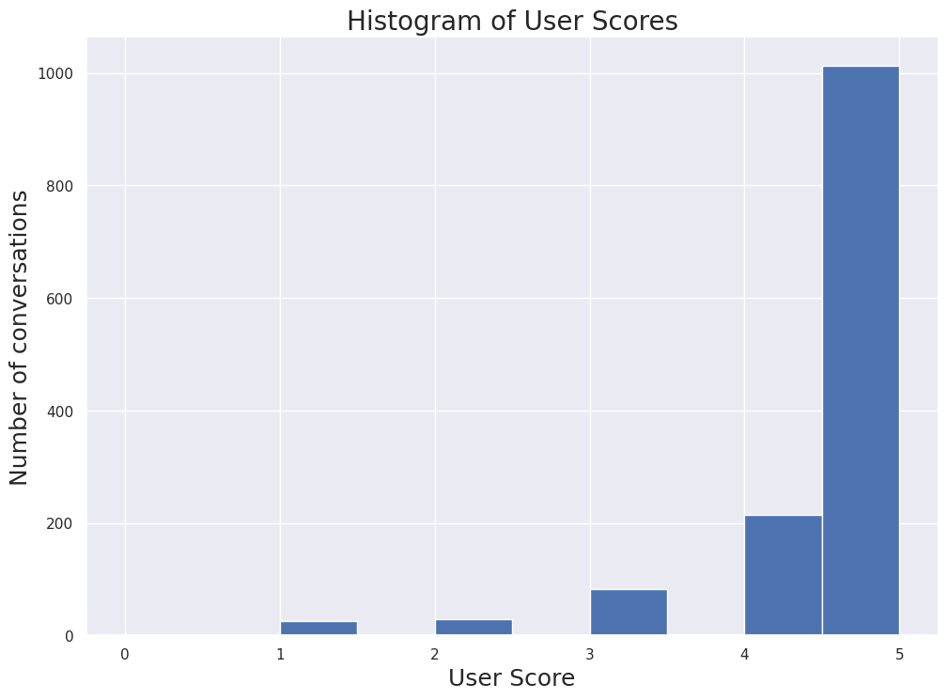
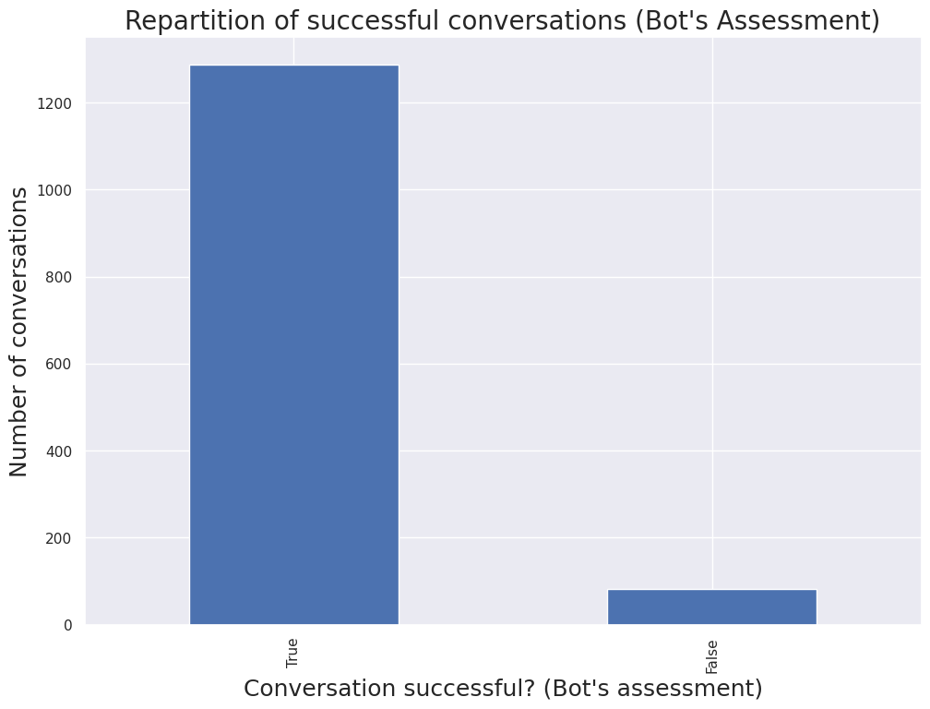
Dataset
Microsoft Frames dataset
1 JSON file with 1369 rows
1369 labelled conversations between a user and a bot
Conversation information:
Text, author, timestamp, labelled intents, labelled categories detected
8676 user turns (we remove wizard responses, total of 16667 turns)
Scoring information
User score, Task Successful boolean
We keep only utterances with user score > 3 and wizard task success

Slide 6
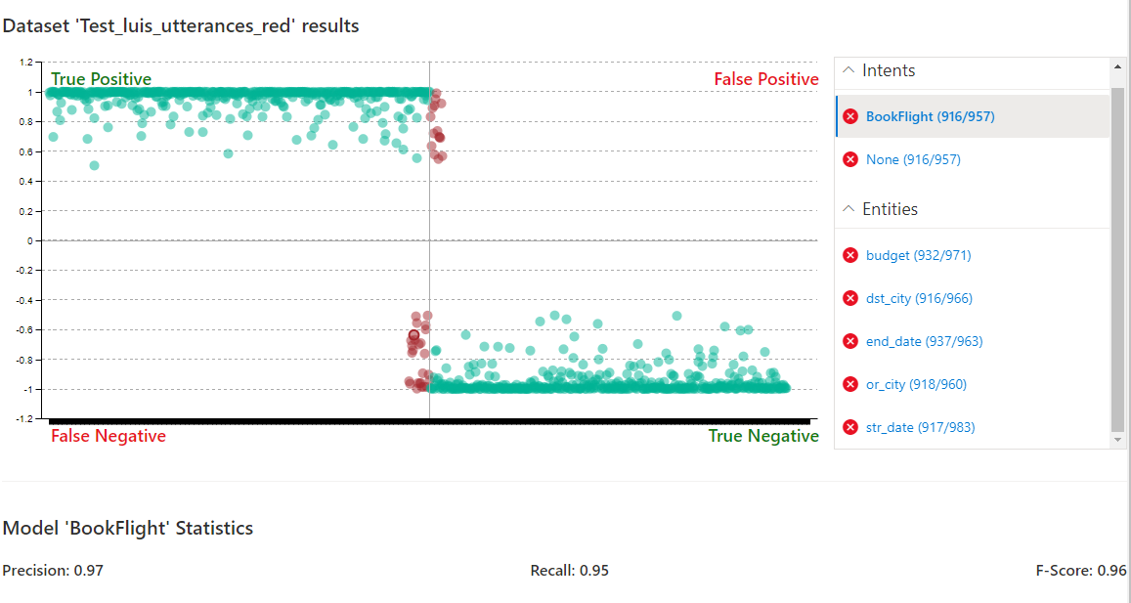
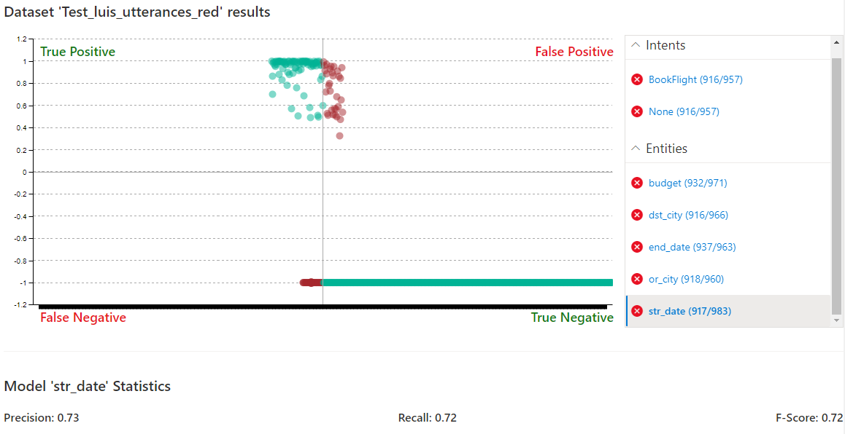
Model Training and Testing
BookFlight Intent
Performing train/test split of turns database
Generating utterances JSON files :
Intent defined based on detected entities
Ignoring columns where the intent is “negate”
Removing “flexible” -1 field and replacing $ with € for string matching
Creation of LUIS application using API
Uploading train utterances by batches (max 100) and training app
Testing app by uploading test JSON on luis.ai website
F-Score results : Intents 0.94
Dates : 0.72 (Start) / 0.8 (End)
Budget : 0.77 / Cities 0.88 – 0.91
F score 0.96
Start Date
F score 0.72

Slide 7
Developing FlyBot

Slide 8
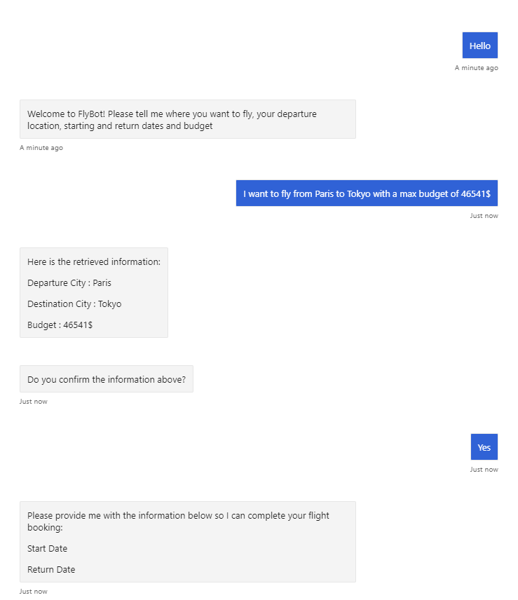
Bot conception and features
Built with Microsoft BotFramework Python SDK
Integration of LUIS Prediction API and Azure Insights credentials in (git-ignored) config file
Unit tests automatically run on Github push, run with Pytest and testing API connections
At end of dialog, user profile saved with booking information
Use of Text prompts (for LUIS API recognition), Choice prompts (to correct wrongly inputed fields) and Confirmation Prompts

Slide 9

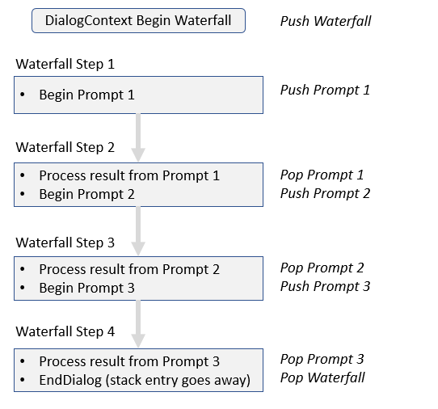
Waterfall Dialog
Principle : Sequential dialog composed of different steps
2 iterations of the following steps :
User query request (Analysis of request with LUIS Prediction API)
User confirmation prompt
Correction of wrong information (if necessary)
If unable to retrieve all 5 elements:
Sequential phase where all missing elements are requested in order
Final step with User Score request

Slide 10
Monitoring the Bot Performance

Slide 11
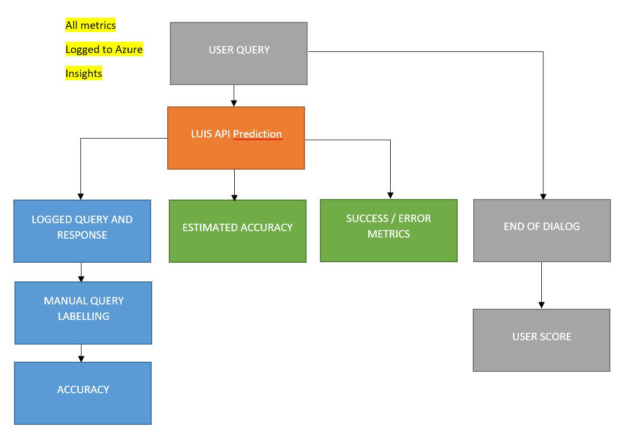
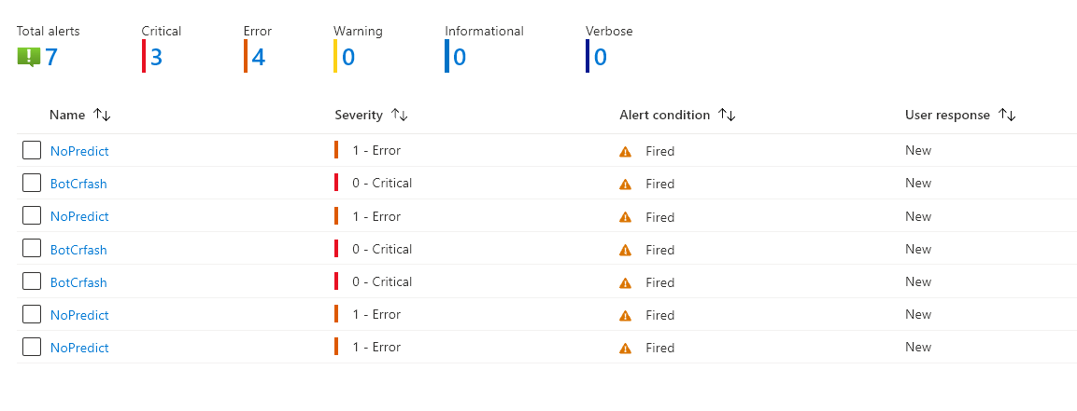
Model Performance Monitoring Architecture
3 types of performance metrics :
User provided metric : user-score
Estimated accuracies :
Global accuracy : calculating the success / request ratio
Entity accuracy : calculating the ratio of entities successfully detected
Log-based metrics can be computed from detailed logs of all predictions
Alerts automatically generated when KPIs are below pre-defined thresholds

Slide 12
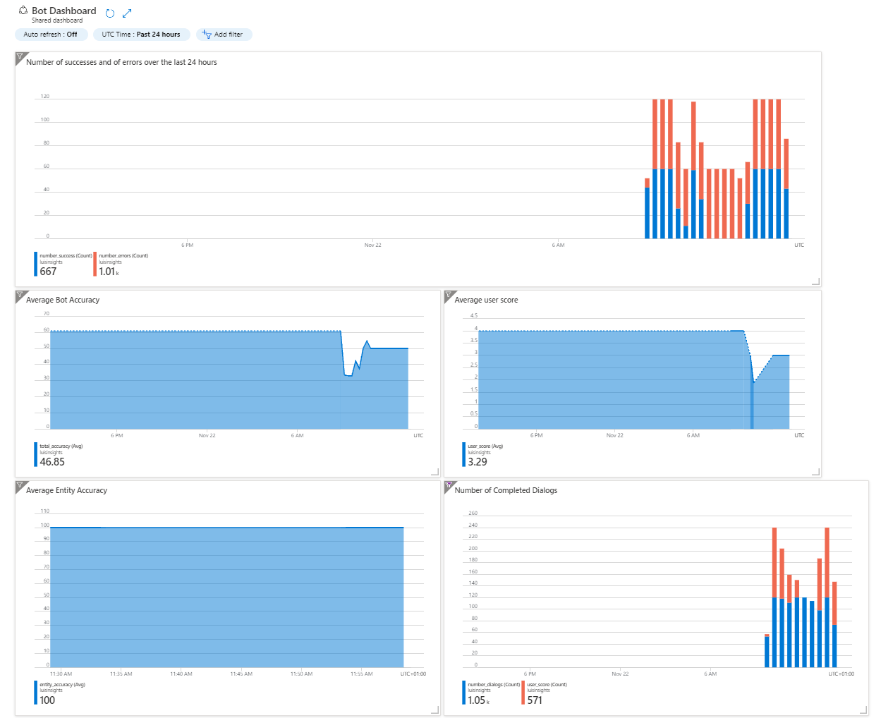

Slide 13
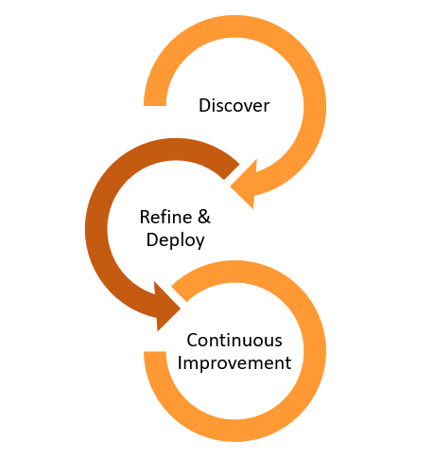
Improving the model performance
Possible to train the models on confirmed predictions with “Good Prediction” logs
Most efficient way to improve the model :
Manually label badly labelled sentences from “Wrong Prediction” logs
Add them to training utterances and rerun tests
Increase the number of train utterances

Slide 14
Conclusion

Slide 15
Conclusion
During this project, a Flight Booking chatbot has been developed which is based on a Microsoft LUIS model.
A complex performance monitoring architecture has been built with Azure Insights to ensure that the bot meets expected quality standards.
Recommendations :
Retrain the model every 10k “Good Prediction” queries labelled by users
Consider performing manual labelling of “Wrong Prediction” queries collected in logs
After production, follow the bot’s performance with the provided dashboard
Set in place periodic retraining of model with new data

Slide 16
Questions?

